Slide 1
SHARK TANK PRESENTATION
PABLO GONZALEZ VELASCO
9C
27/10/2020

Slide 2
PROPOSAL OF MY PROJECT
What I want to show in my project is a timeline that is around a soccer field where there will be photographs, trophies, texts, that are related to soccer, all these objects present are part of my archive. In the center of the soccer field would be the title in the stencil technique, the title would a sentence of a text that i choose. Here I am going to use different techniques such as blackout poem where I am going to remove the least important of the present texts, I am also going to use Christian Boltanski as a reference due that his works have many photos, of families, friends, between others and mine will be present all these characters that have shared with me during this timeline.

Slide 3
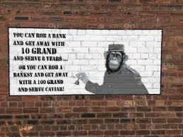
Bansky
Bansky is an Englan street artist, the technique that he uses is stencils that is basically used with grafitis. His works are based on political and social commentarys that he had been develop around the streets of all the world.

Slide 4
Christian Boltanski
Christian Boltanski was a french artist, that is known basiccally from his installations, photographys, cinema, sculpture techniques that he develops in his pieces of art.

Slide 5
Blackout Poem
Blackout Poetry stems from found poetry and is characterized by the use of a marker to existing text and redacts words until a blackout or redacted poem is formed.

Slide 6
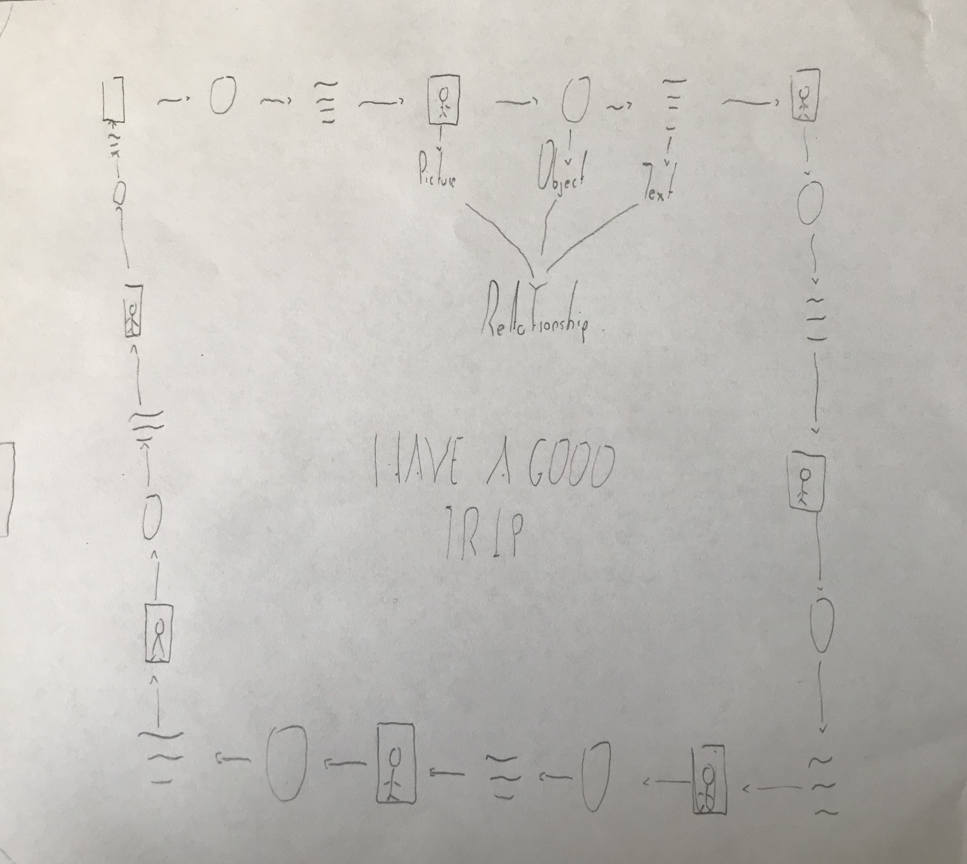
SKETCH
In the sketch we can see a soccer field where the work of art is presented, inside it it looks like a square that is the installation of the artistic work, it is a timeline where each one will have a photo, an object and a text of everything that happened in the moment. In the center you can see the title that refers to the stencil technique. What I want people to feel when seeing this, is to say the evolution of a tradition that has been carried for years, right here you can see the relationship with all the chosen references.

Slide 7
MATERIALS AND BACKGROUND
MATERIALS:
Trophies
Texts
Pictures
Soccer balls
Stencil
Grafitis
The background that i will use is the soccer field of Gimnasio Campestre or Club Guaymaral depending in which i could do it, due that all my project is related with soccer and this are a perfect spot for showing something related to soccer.

Slide 8
WHY BUY MY PROJECT?
You should buy my idea since it is an idea that is related to a past and to the archive, here as I explained to you, you can see a relationship between everything that is present. It is something very interesting that no matter how much family and memories are, there is one more feeling that is football that makes everything better and clearer.

Slide 9
BIBLIOGRAPHY
http://digicult.it/news/christian-boltanski-dopo/
https://en.wikipedia.org/wiki/Banksy
https://es.wikipedia.org/wiki/Christian_Boltanski

